Slide 1
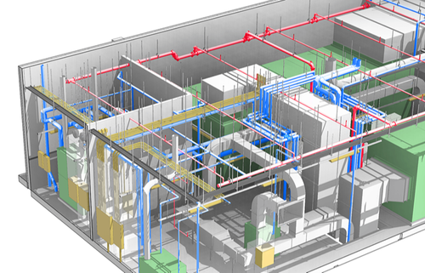

ASHRAE 2022 HVAC Competition
Team A10
Matthew Newman, Hammoud Farhan, Joseph Tyler, Zach Delong
Team Coordinator/Advisor: Dr. Hamid Heravi

Slide 2
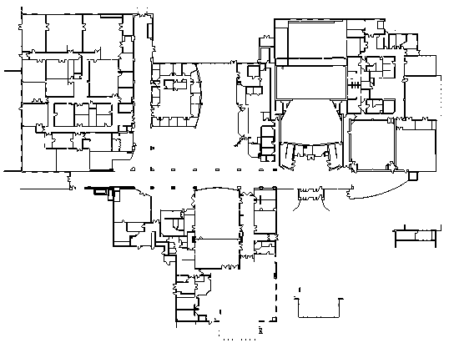
Problem Statement
The Goal of The ASHRAE HVAC competition is to design a functional HVAC system and calculate heating and cooling loads.
The Building we are working with is a performing arts school with an area of 23,300 m² located in Sydney, Australia.
Figure 1: Floor Plan of the Building

Slide 3

Implication of Project Success
Figure 2: UN Sustainable Development Goals (SDG)

Slide 4
Project Related SDG’s
SDG 3: Good Health and Wellbeing
Quality HVAC systems can reduce the spread of COVID 19 and filter the air from harmful particulates.
SDG 9: Industry Innovation and Infrastructure
This building will provide jobs and further technological development in Australia.
SDG 11: Sustainable Cities and Communities
The number of people living in cities is expected to rise and those people are going to need ventilation and air conditioning.
SDG 13: Climate Action
In the United States almost 35% of CO₂ emissions are linked to HVAC systems.
Designing energy efficient HVAC systems is crucial to reducing greenhouse gas emissions.

Slide 5
Functional Requirements
Table 1: Functional Requirements
Number | Requirement | Priority | Metric | Target | Justification
1 | Thermal comfort | Not negotiable | Predicted mean vote | 80% feel comfortable | Owner requirements
2 | Indoor air quality | Not negotiable | Presence of harmful particulates | Less than 0.3 mg per m³ of air | Owner requirements
3 | Noise Level | Not negotiable | Decibels | Max 85 but should be~40 | Australian standards*
4 | Efficiency | Not negotiable | Output electricity | Greater than 20 | Owner requirements
5 | Heating and cooling loads | Not negotiable | Temperature | Heating 65 F Cooling 72 F | Owner requirements
6 | Energy Use Intensity | Negotiable | kBTU/year | Minimum | Owner requirements
* Australian Government National Occupational Health and Safety Commission link

Slide 6
Design Constraints
Table 2: Design Constraints
Number | Requirement | Priority | Metric | Target | Justification
1 | Cost | Not negotiable | $ | Maximum $15 million | Owner requirements
2 | Location | Not negotiable | A map | Sydney Australia | Owner requirements
3 | Type of floor | Not negotiable | Type | Poured concrete | Owner requirements
4 | Type of walls | Not negotiable | Type | Masonry walls | Owner requirements
5 | Synergy with surroundings | Negotiable | Appearance and impact | Complies with the surroundings | Owner requirements
6 | Life cycle function | Not negotiable | Functional time | Components must perform | Owner requirements

Slide 7
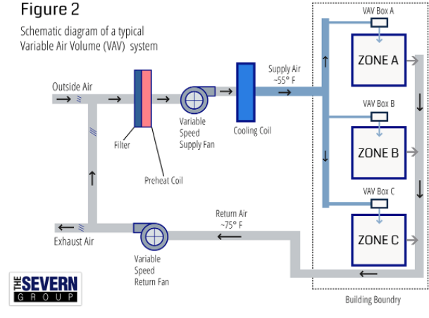
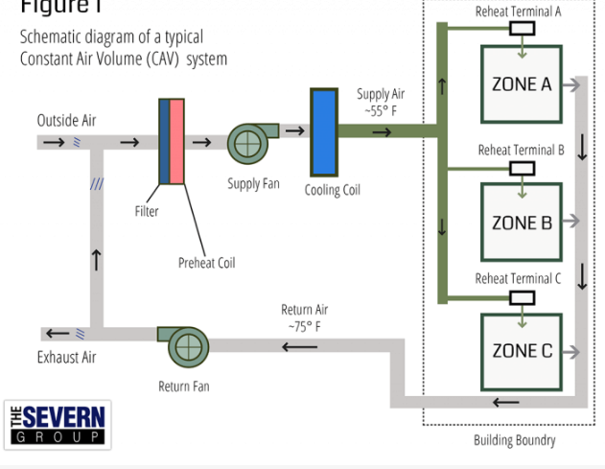
Proposed Solutions
Variable Air Volume (VAV) System
Air flow rate regulated independently at each heating zone.
This allows for room temperature variation depending on the needs of a space.
Constant Air Volume (CAV) System
Constant air volume systems pump air around the building but doesn’t bring in fresh air from outside.
They aren’t able to control the air temperature independently for each room.
Figure 3: VAV system
Figure 4: CAV system

Slide 8
How Does an HVAC System Work?
Heat Pump
The heat pump is a device that pumps heat from one location to another. Like an air conditioner.
VAV (Variable Air Volume)
VAV system regulates how much air is pumped into each room. By changing the rate of air flow you can modulate temperature.
Air flow is regulated with Fan Terminal Units (FTU)s placed in each temperature zone.
Filters and Ductwork
Fairly self explanatory, these provide a pathway for the air to flow throughout the building and remove air pollution.
Furnace or Other Heating Unit
Sometimes this is not necessary depending on the efficiency of the heat pump.
This can be fueled by either electrical or gas.

Slide 9
RTS Hand Calculations
The RTS procedure is used for calculating the heating and cooling loads inside a building.
The steps for using the RTS procedure are…
Calculate solar intensities for each exterior surface.
Calculate Sol-Air temperature for each hour.
Determine lighting, equipment and occupant heat gains.
Calculate solar and conductive heat gain through each window.
Calculate solar heat gain and conductive heat gain for each wall.
Split heat gains into radiant and convective portions.
Add a delay for each radiant heat gain.
Sum the radiant and convective portions back together to get the hourly cooling load.

Slide 10
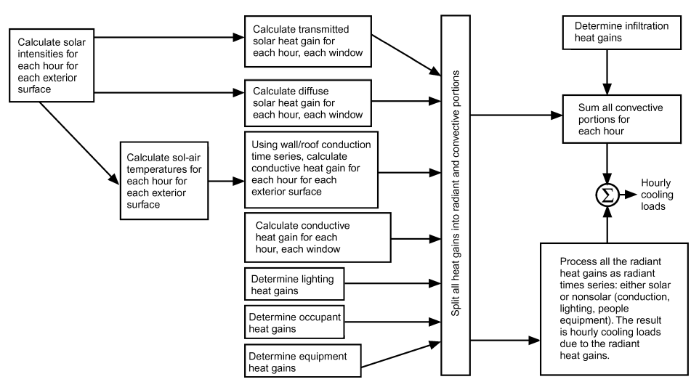
RTS Hand Calculations
Figure 5: Diagram of RTS Procedure

Slide 11
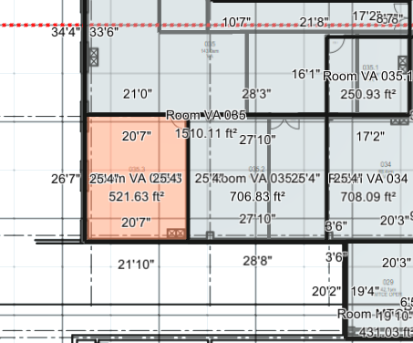
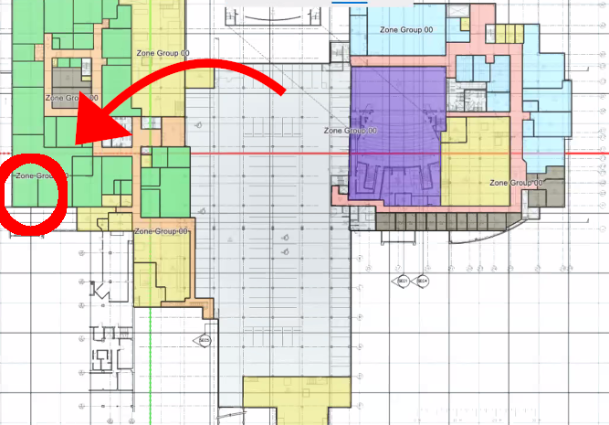
Example Calculations
Room VA 035.3 is the example for this calculation
On the below grade floor.
Two exterior walls, one on west and one on south.
Figure 6: Blueprint of example room
Figure 7: Example room in simulation

Slide 12
Solar Intensities
Calculate AST (Apparent Solar Time) Based off of the location of Sydney, Australia
-1.13
Hour angle =15*(AST-12)
-197deg
Solar Altitude Beta
-69.88
Solar Azimuth Phi
-52.35
Surface-solar azimuth gamma
Because we are using the south facing wall it is the same as Solar Azimuth Phi -52.35
incident angle theta
77.9 Degrees
Total Surface Irradiance
The sum of ground reflected irradiance, diffuse irradiance, and surface bean irradiance.
In this case Total surface Irradiance = 0. It is the middle of the night.

Slide 13
Calculate Sol-air Temperature
T_{air-sol} = T₀ + (a*E_{t}/h₀) - (eR/h₀)
E_{t} = Total Surface Bean Irradiance that we calculated from last slide.
a/h₀ = 0.3 for dark surfaces
eR/h₀ = 0
T₀ = the outside temperature = 72.9 ℉
T_{air-sol} = 72.9 ℉
24 hour air-sol (℉)
72.9
72.3
72.1
72.1
71.8
152.7148924
146.2118384
141.871294
139.3292804
79.95776607
93.32309168
100.5757353
105.7884068
104.070191
106.1813103
102.5458791
94.744017
92.292258
85.886422
85.5
84.4
83.3
80.6
77.7

Slide 14
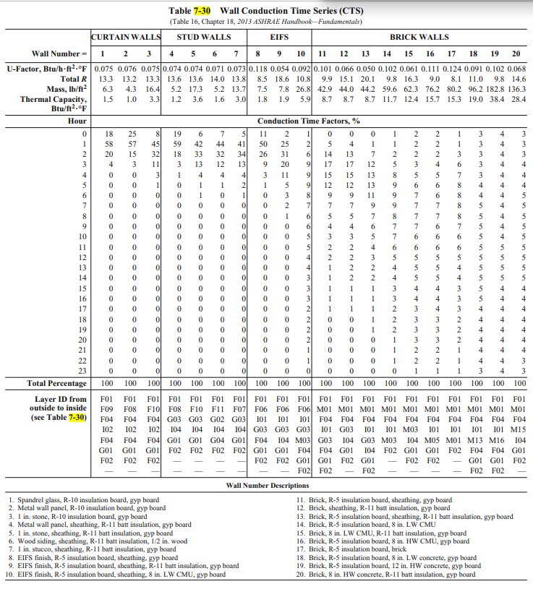
Conduction Time Factors
A delay is added to account for conduction.
In this case we use wall type 1 spandrel wall.
Figure 8: Wall conduction time series

Slide 15
Conduction Time Series
 | Hour 1 | Hour 2 | Hour 3 | Hour 4
Conductive heat gain (UA*[T_{e}-T_{indoor}] ) | -58.58 | -63.53 | -65.18 | -65.18
Conduction time factor (Table 7-30, wall number 1 for spandel wall in this case) | 0.58 | 0.20 | 0.04 | 0.00
Total Wall heat gain using conduction time series (, q₁₅ = c₀q_{i,θ} + c₁q_{i,θ-1} + c₂q_{i,θ-2} + … + c₂₃q_{i,θ-23}) | -19.47 | -49.01 | -61.05 | -64.58

Slide 16
Hourly Occupant and Lighting Heat Gains.
110 W lighting in room operating from 7:00 am to 7:00 pm.
1 person 8:00 am to 5:00 pm
Table 3: Hourly occupant and lighting heat gains.
Hour | On/Off | Heat load | Convective | Radiative | Total
6 | 0 | 0 | 0 | 17.88204 | 17.88204
7 | 1 | 392.15 | 168.6245 | 125.1743 | 293.7988
8 | 1 | 392.15 | 168.6245 | 160.9384 | 329.5629
9 | 1 | 392.15 | 168.6245 | 178.8204 | 347.4449
10 | 1 | 392.15 | 168.6245 | 187.7614 | 356.3859
11 | 1 | 392.15 | 168.6245 | 192.2319 | 360.8564

Slide 17
Add a delay for radiative heat gains and sum everything back together.
Table 4: Hourly cooling load calculation
Hour | Wall 1 | Wall 2 | Lighting | Total
6 | 39.88 | 24.62 | 17.88204 | 82.38
7 | 356.21 | 353.89 | 293.7988 | 1303.90
8 | 469.80 | 499.33 | 329.5629 | 1598.69
9 | 488.98 | 562.81 | 347.4449 | 1699.23
10 | 412.64 | 505.05 | 356.3859 | 1574.07
11 | 190.51 | 235.81 | 360.8564 | 1087.17
Peak Load 1699 BTU/h

Slide 18

Trace 3D Plus
Trace 3D is part of our Design Process
It is a simulation software that allows for simulated load design, Manual tracing of a PDF schematic to scale
The building will have many functions ranging from music, cooking, and computer rooms.
The goal for utilizing Trace3D Plus will be to model the design with each zone in mind.

Slide 19
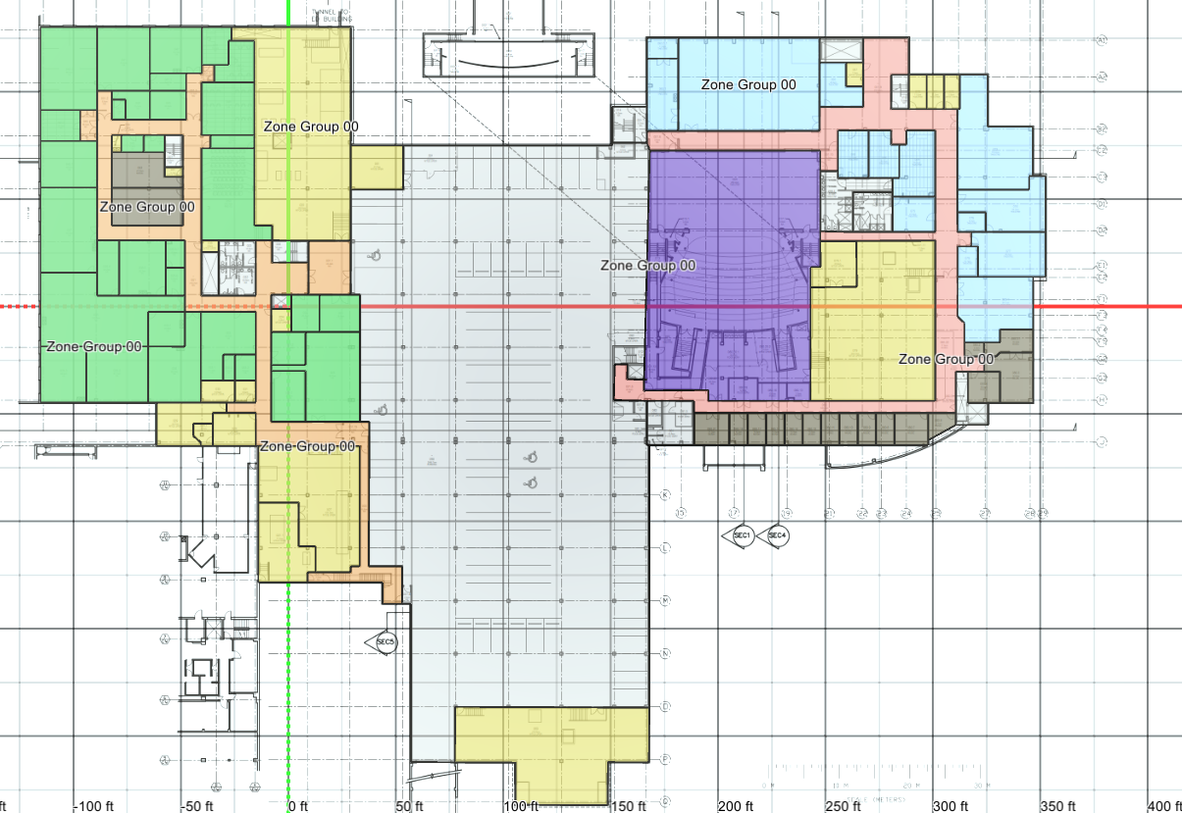
Trace 3D Plus
Trace 3D Plus is an HVAC modeling and simulation software
Accounts for various important factors when modeling building
Allows for extensive HVAC system creation
Provides accurate load results if simulated correctly.
Figure 10: Simulation floor blueprint

Slide 20
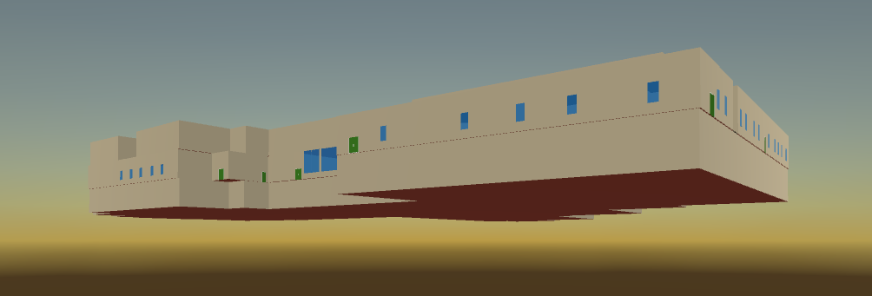
3D Model
Figure 11: 3D model of the building

Slide 21
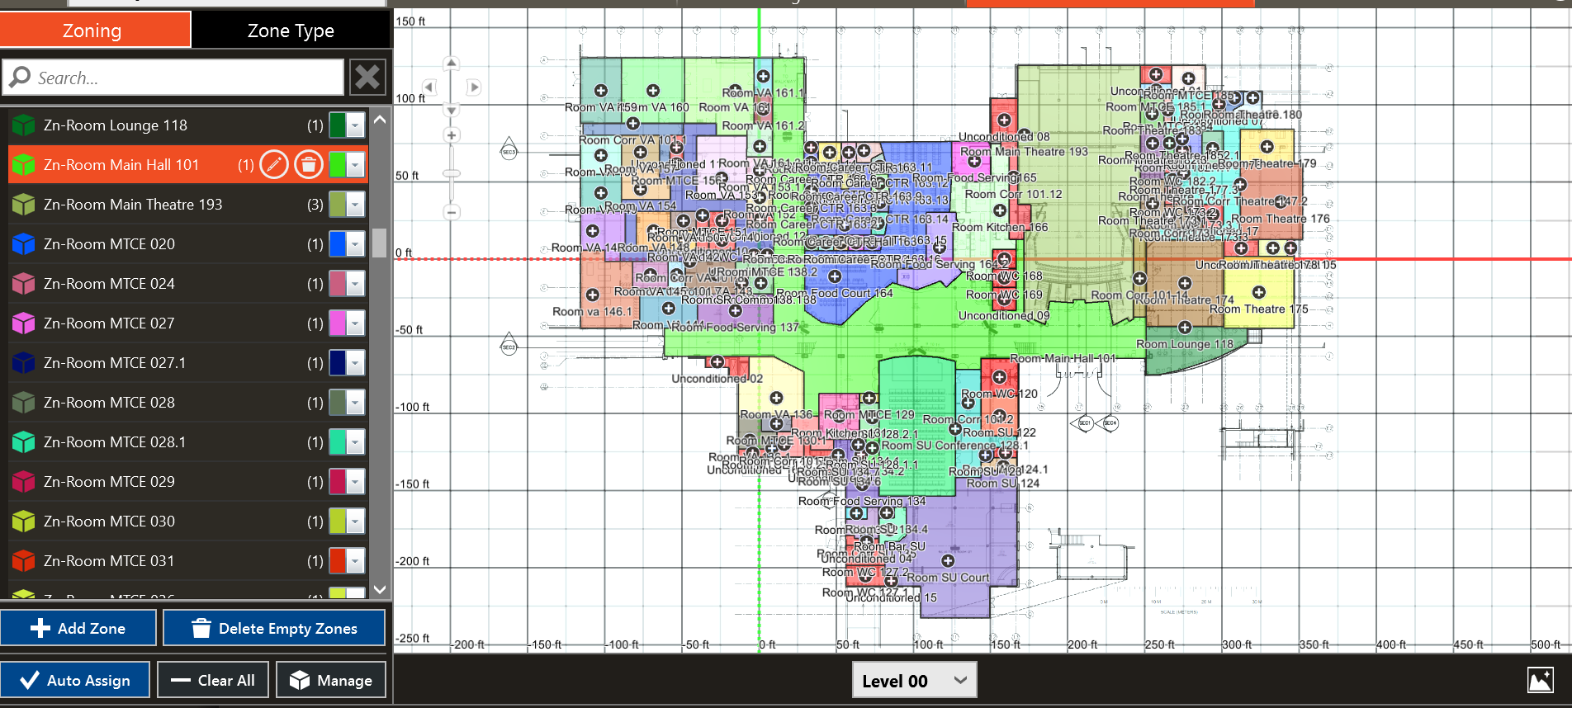
Room types
Room types are set in software using predetermined categories
Categories come preloaded with ASHRAE standards and parameters
Rooms are grouped and color coded
Figure 12: Rooms Grouped in Trace 3D plus

Slide 22
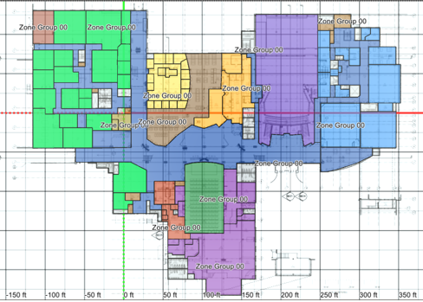
Zoning
Thermal zones are selected based on desired temperatures and humidity
Room types are grouped into zones based on similar desired conditions
Zoned each zone corresponds to one room type
Also color coded
Multi-zone systems
Single zone systems
Figure 13: zoning in Trace 3D plus

Slide 23
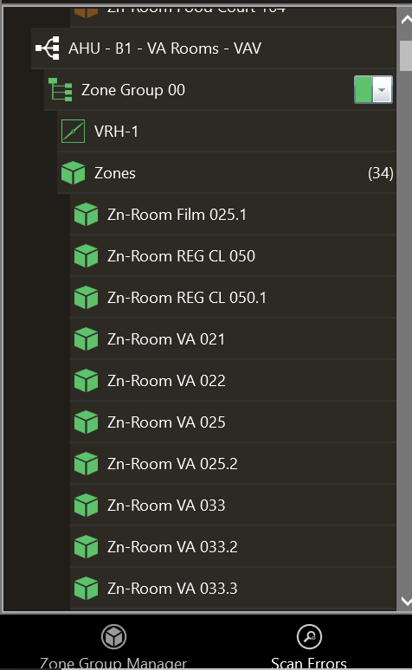
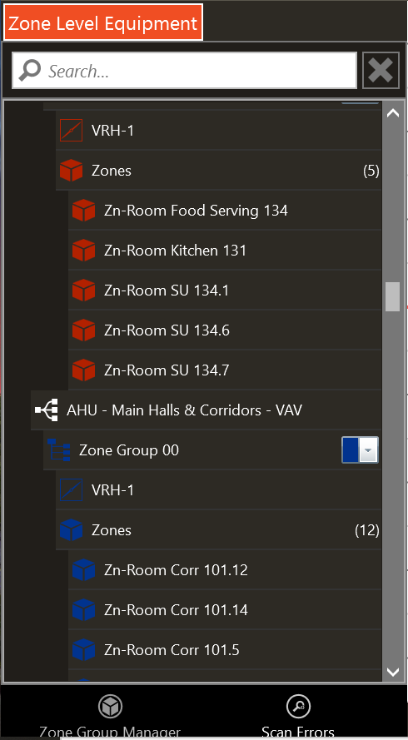
Systems
Systems and plants are selected to heat or cool various zones
Multiple systems were incorporated due to different zones and room types
Single zone CAV system
VAV system

Slide 24
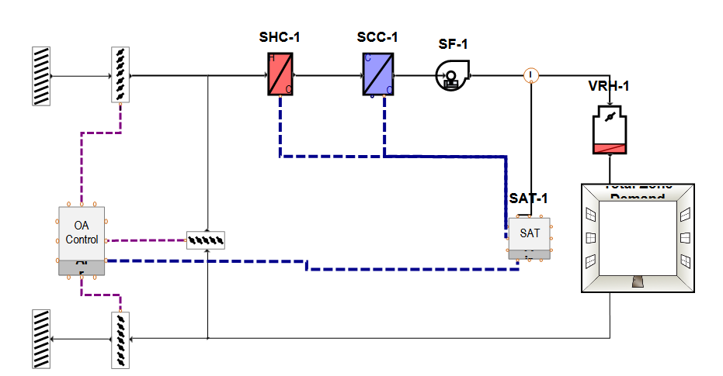
Plants
Plants are the cooling and heating sources for system
Cooling plant
Heating plant
Figure 14: VAV reheat

Slide 25
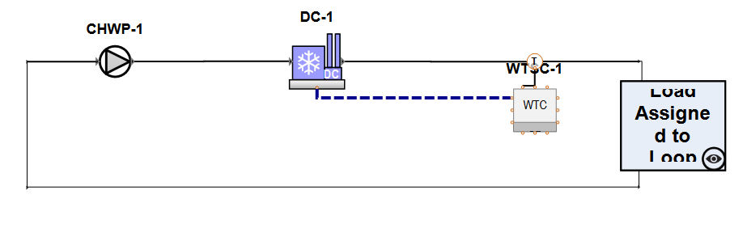
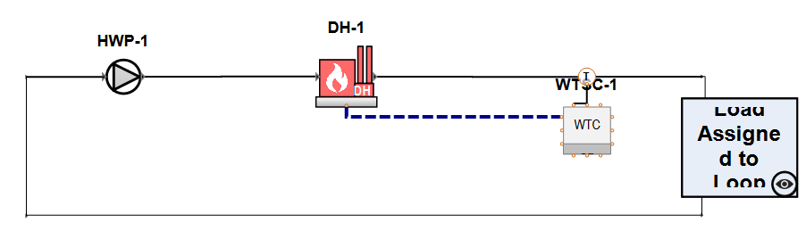
Plants
Figure 16: Chilled Water Loop Cooling Plant
Figure 15: Hot Water Loop heating Plant

Slide 26
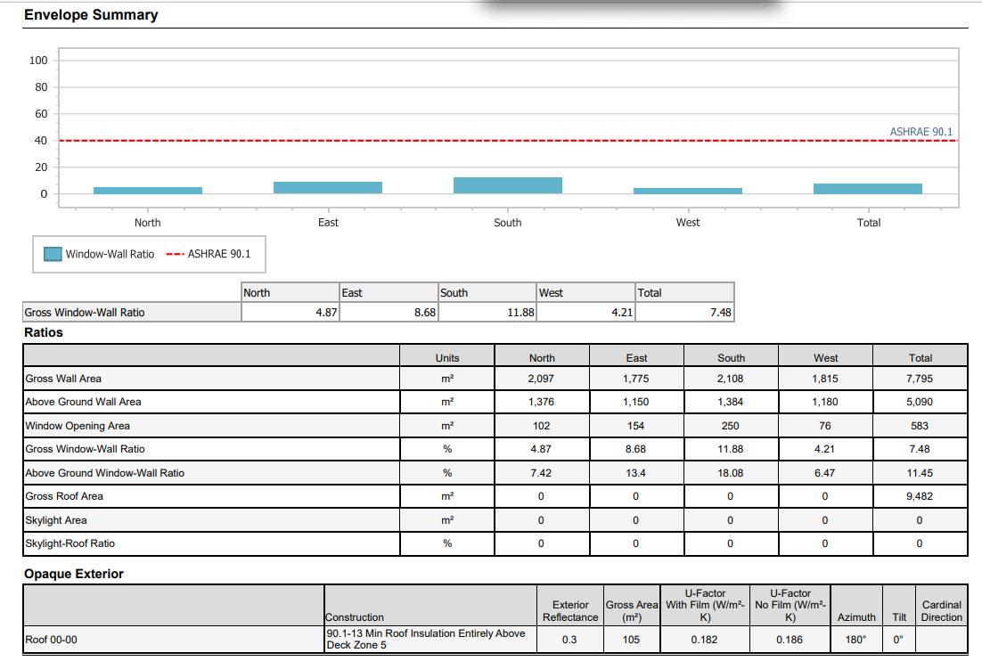
Load Envelope Summary from Trace 3D Plus
Opaque Exterior Surfaces
Roof
Floor Slabs
Walls
Fenestration (doors)

Slide 27
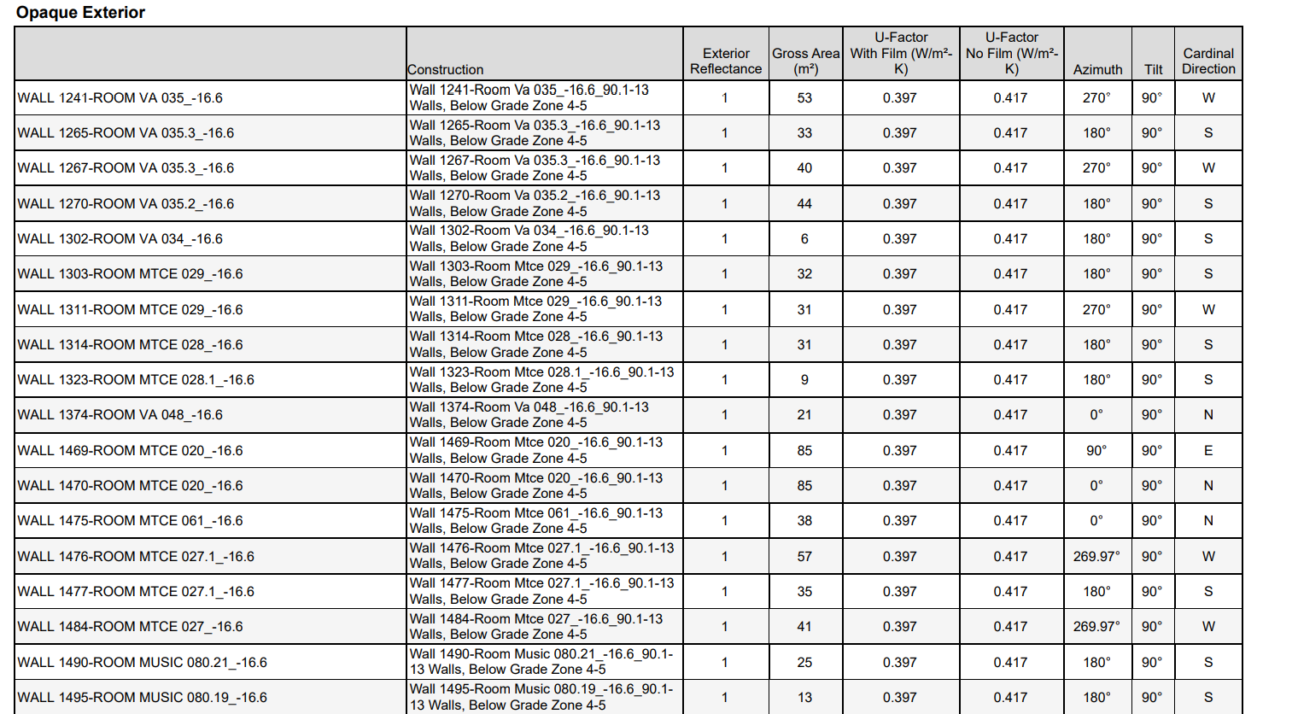
Load Envelope Summary from Trace 3D Plus

Slide 28
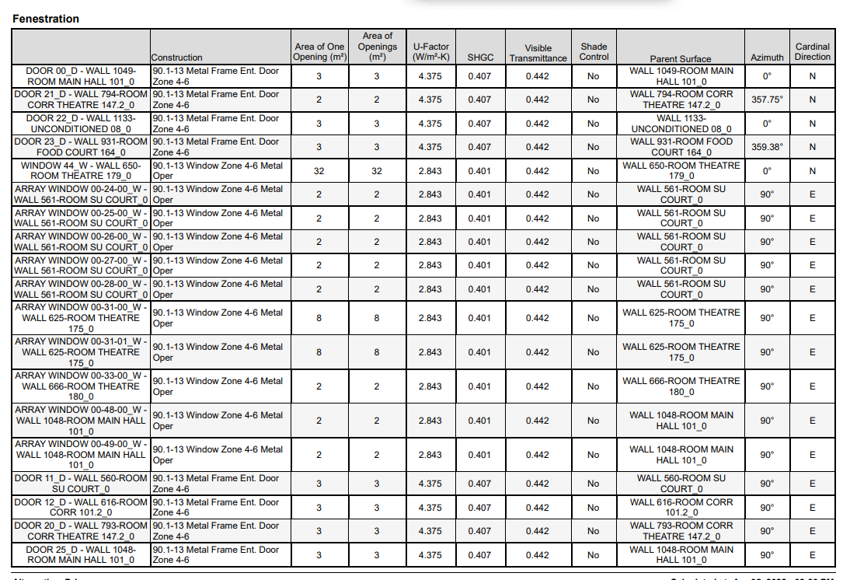
Load Envelope Summary from Trace 3D Plus

Slide 29
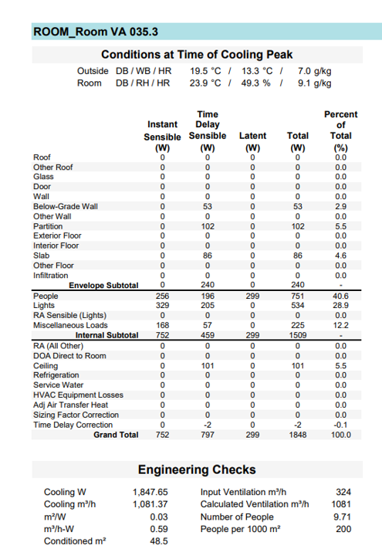
Simulation results for room VA 035.3
1848 BTU/h Peak Load
Figure 9: Simulation results for example room

Slide 30
Test Methods
Simulation and RTS comparison
Room being compared is VA 035.3
RTS peak cooling load = 1699 BTU/h
Simulation peak cooling load = 1848 BTU/h
%Error = (1848-1699)/1848*100 = 8%

Slide 31
Budget
For our project we didn't have to incorporate budget because our project is based on simulation and manual calculations

Slide 32
Schedule
Remaining Assignments
Poster 4/19
Final Design Document 4/25

Slide 33
SUMMARY
The objectives previously mentioned will be met by:
Gaining a stronger foundation in testing methods and analysis.
Opportunities to develop solutions by identifying theoretical and practical applications.
Developing and/or utilizing an established form of testing that will provide a measurable to compare data.
Discovering necessary adjustments to be made as well as factors to be considered in the design and implementation of choosing materials that will meet specifications.

Slide 34
RELEVANT ASHRAE STANDARDS
ANSI/ ASHRAE/IESNA Standard 90.1
This standard provides the minimum requirements for energy-efficient design of most buildings, except low-rise residential buildings.
ASHRAE 55
ASHRAE defines comfort in the Thermal Environmental Conditions for Human Occupancy Standards, “The environment that provides mental satisfaction for the occupants”. Thermal Comfort is a key factor in the design process of HVAC Systems. As such, thermal comfort is analyzed separately for each system. Comparatively speaking, a person sitting on a desk generates about 400 BTU/Hour; whereas, a single light bulb produces approximately 340 BTU/Hour. ASHRAE Standard 55 specifies conditions for acceptable thermal environments and is intended for use in design, operation, and commissioning of buildings and other occupied spaces.

Slide 35
REFERENCES
ASHRAE. (2019). The Standards for Ventilation and Indoor Air Quality.
Trane. (2021). Trace 3D Plus. https://www.trane.com/commercial/north-america/us/en/products-systems/design-and-analysis-tools/trane-design-tools/trace-3d-plus.html
Bahatia, A. (2012). HVAC Design Overview of Variable AirVolume Systems. PDH Online. https://pdhonline.com/courses/m252/m252content.pdf
Weatherspark.com. (n.d). ( Sydney Climate, Weather By Month, Average Temperature (Australia) - Weather Spark, weatherspark.com/y/144544/Average-Weather-in-Sydney-Australia-Year-Round#Figures-ObservedWeather.
Ajay N Bhagwat, S. N. (2015). Review Paper on Energy Efficiency Technologies for Heating , Ventilation and Air Conditioning (HVAC). International Journal of Scientific and Engineering Research, 6(12).
Arsha Viswambharan, S. K. (2014). Sustainable HVAC Systems in Commercial And Residential Buildings. International Journal of Scientific and Research Publications, 4(4).
EPA. (2021, October). Heating, Ventilation and Air-Conditioning Systems, Part of Indoor Air Quality Design Tools for Schools. Retrieved from https://www.epa.gov/iaq-schools/heating-ventilation-and-air-conditioning-systems-part-indoor-air-quality-design-tools
Howell, R. H. (2017). Principles OF HEATING VENTILATING & AIR CONDITIONING. (8th, Ed.)
Junjing Yang, H. J. (2018, September). Energy Efficient HVAC Systems.

